Slide 1
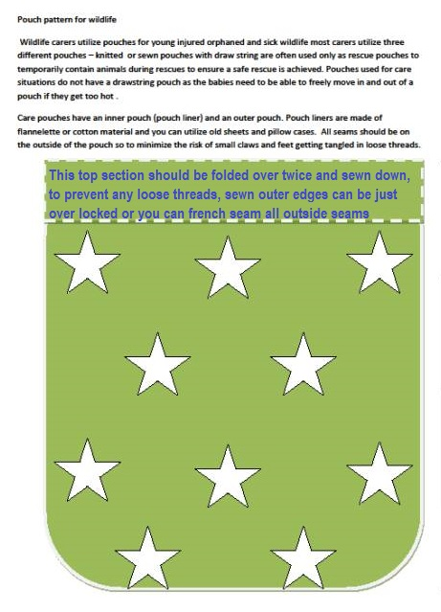
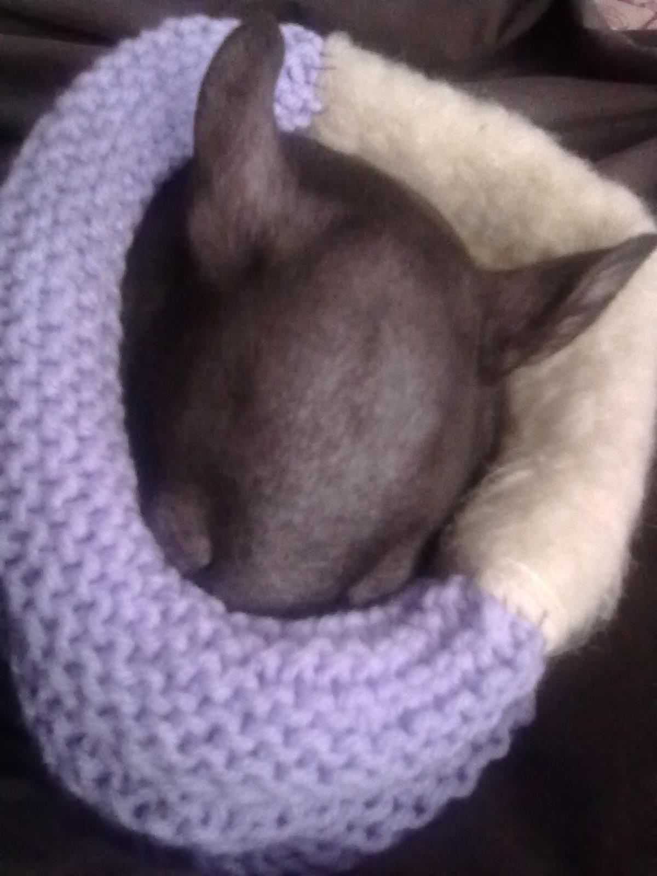
Animalia preference is NO drawstring pouches
Basic Pouches are utilised in a variety of sizes and shapes however the pouch should be longer than wider, most popular sizes used are 10 x 12 cm,15cm X 20cm,20cm x 25cm,30cm x 35cm these sizes are after construction or finished project. Please read all instructions and explanations to ensure the pouch you make can be used.

